Slide 1
Installing OpenXData and OpenDataKit
Andrew Wong-Rolle Intern, SAANS Medical

Slide 2
Architecture I Used
Ubuntu 14.04 LTS 64 bit
Dual-boot (laptop also runs Windows 7)
Tomcat 6 (not the latest version, but Tomcat 7 is not supported by ODK)
MySQL
I originally tried to install MySQL and Tomcat on Ubuntu 12.04 in a VM, but this ended up being too slow.

Slide 3
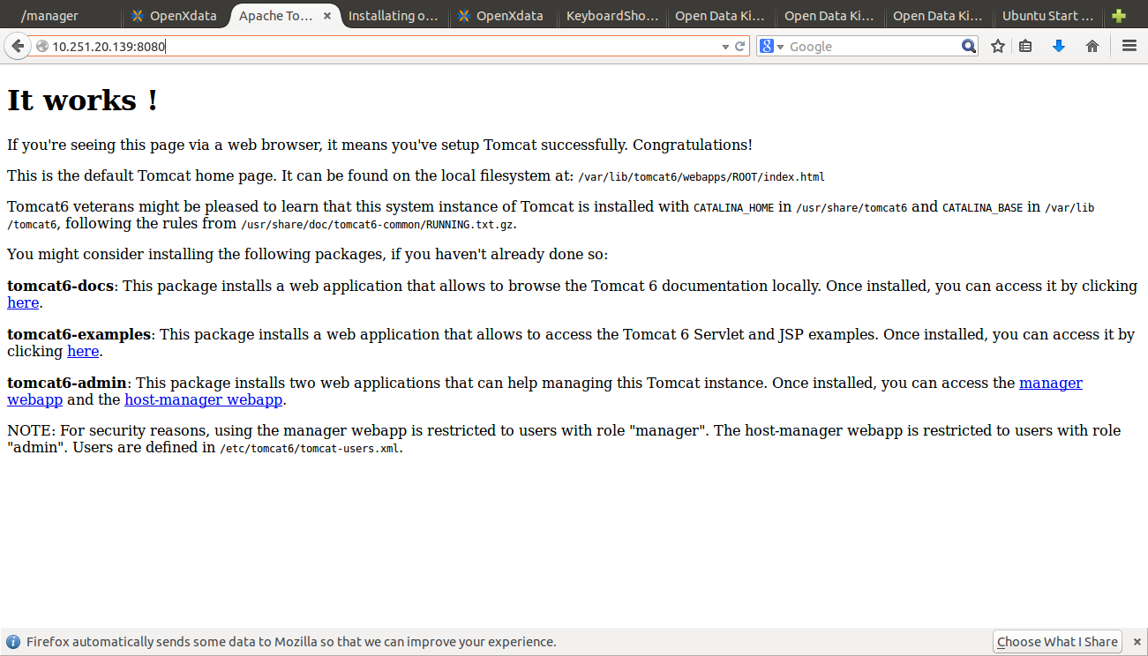
Installing Tomcat 6
Instructions for Tomcat 6 can be found online, and are fairly intuitive.
One important point is to install the tomcat6 manager webapp. This lets you manage webapps with a GUI.

Slide 4
Tomcat6 Directories
Note: this is for Linux distribution.
/var/lib/tomcat6/webapps: this is where the .war files for your webapps will live.
.war is the file type of webapps (including OXD and ODK).
/usr/share/bin: this is where different libraries (including SQL) will live.

Slide 5
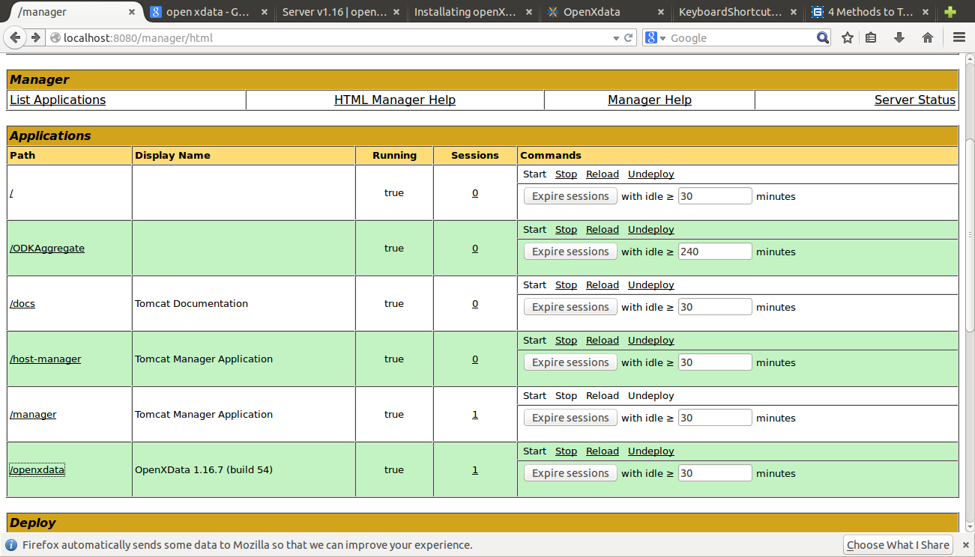
Example: Tomcat 6 with webapps installed
Here is an example of the view from Tomcat 6’s webapp manager feature. In this example, both ODK Aggregate and OpenXData are installed.

Slide 6
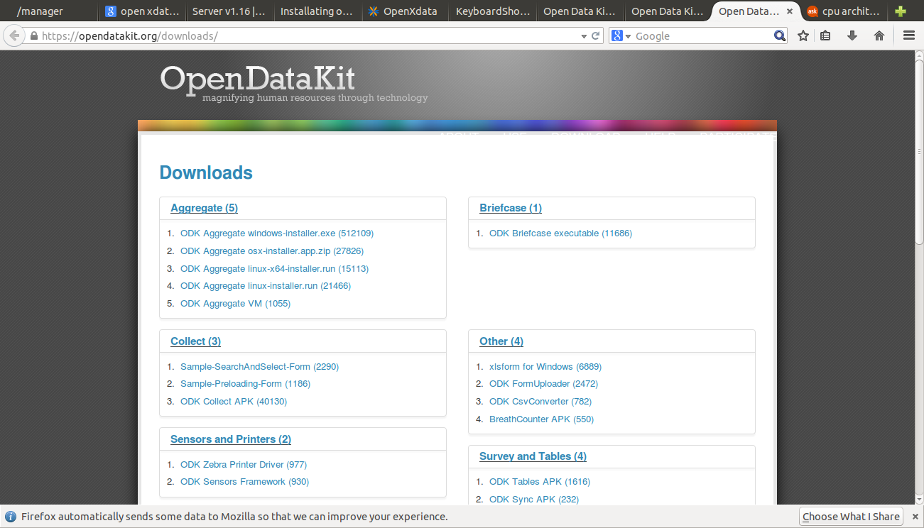
Installing ODK with Tomcat 6
ODK Aggregate is available for download from the above web page. For my installation, I chose the third link.

Slide 7
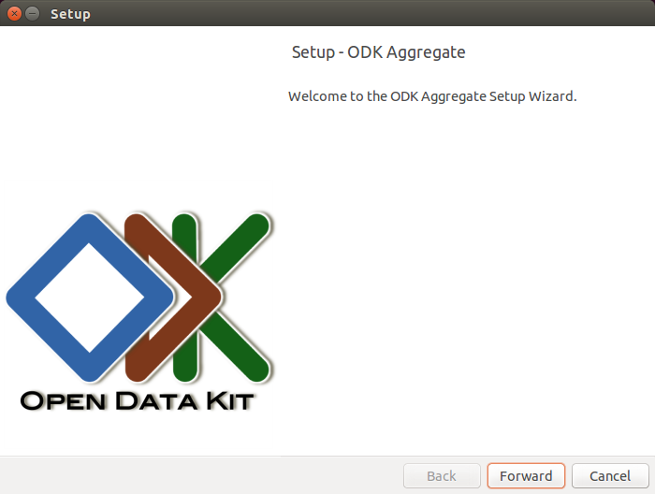
ODK Setup
Notes: In order to get to this screen, there are many prerequisites which must be installed first. These include:
Installing Tomcat6.
Installing MySQL.
Downloading the ODKAggregate.run file, and changing it to be user-executable (chmod +x).
Running the ODK installer will require you to enter all your MySQL login information.

Slide 8
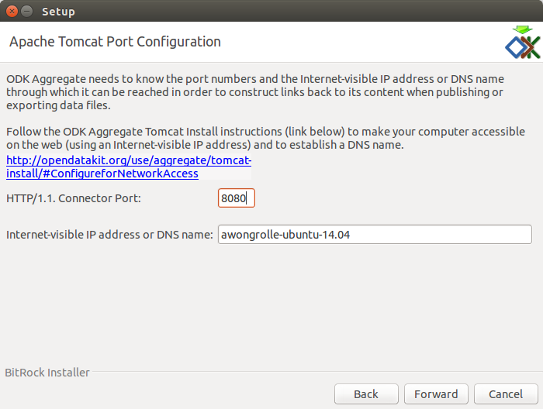
Configuring ODK
For my installation, I chose to run ODK Aggregate on port 8080, and MySQL on port 3363.

Slide 9
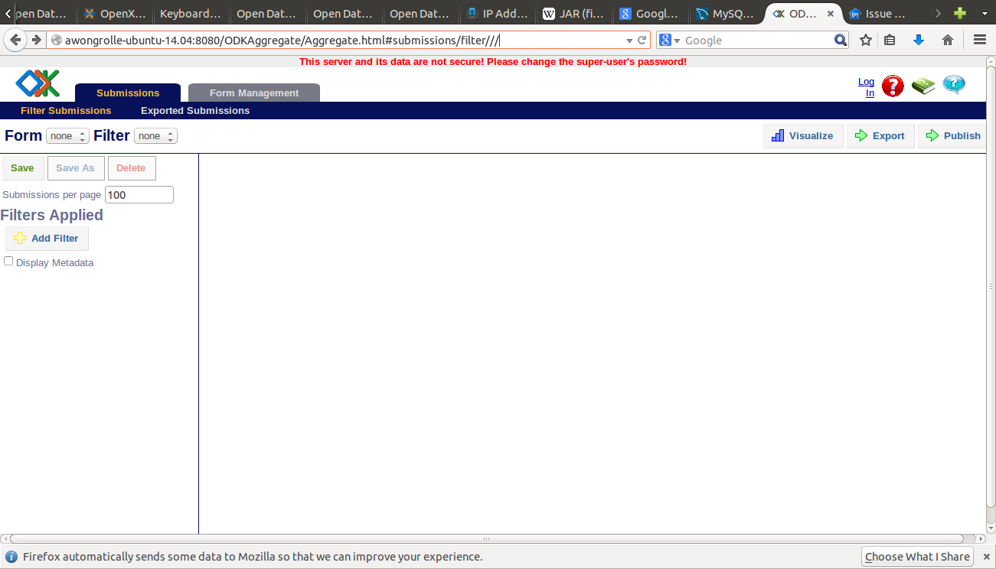
ODK Installed!
As you can see, the url for ODK Aggregate depends on the information given during installation. This shows ODK successfully installed, but not logged in.

Slide 10
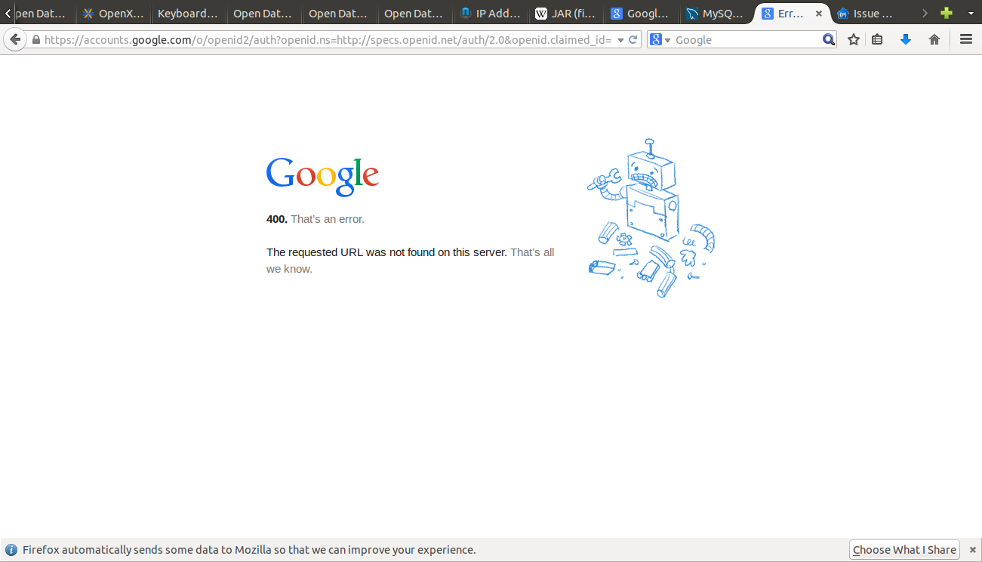
Problems with ODK
I was unable to install and host ODK, but I was unable to log in as an administrator.

Slide 11
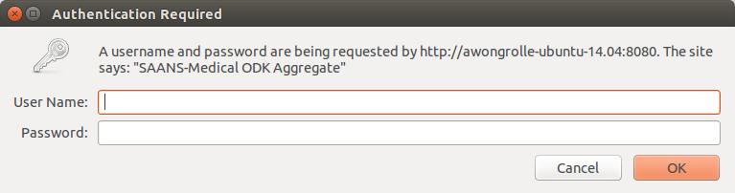
Problems with ODK
Although I created a username and password when installing ODK, I was not able to login using this same username and password.
I uninstalled and reinstalled ODK twice, yet had the same problem all three times.
From the tomcat error message, I was able to figure out that the username existed, but the password was marked incorrect.

Slide 12
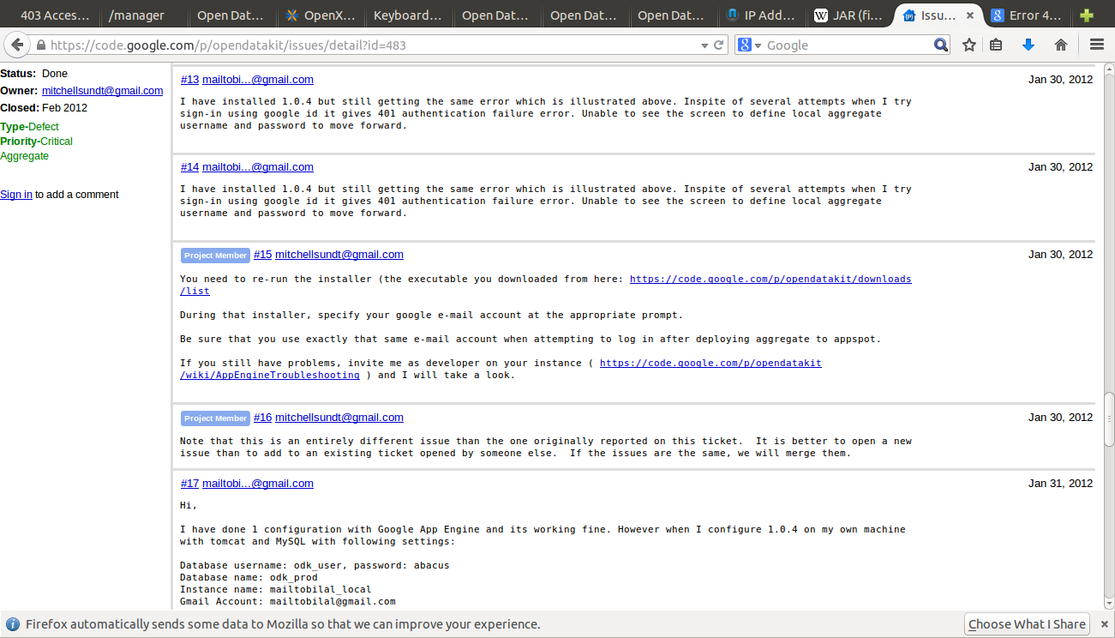
Error thread for ODK

Slide 13
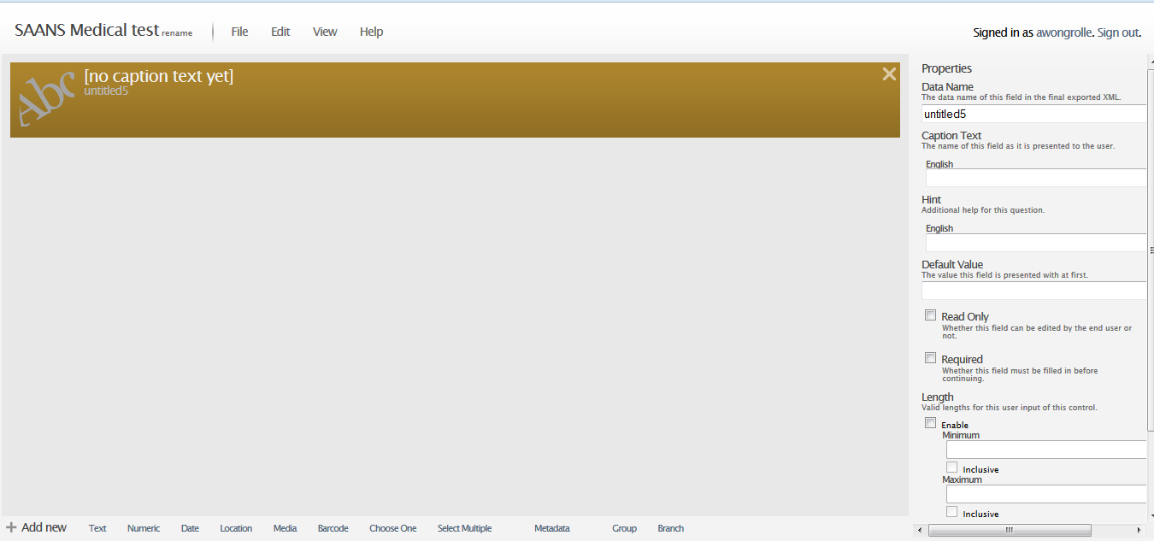
ODK Build
An example of the screen for creating forms in ODK Build, the online resource. This does not provide the capacity for hosting forms, only for designing them.

Slide 14
Installing OpenXData
OpenXData was significantly easier to install, however, this could be due to the fact that I had already installed the prerequisites (tomcat6 and MySQL).
I hosted OXD in the form of a webapp (a .war file which lives in the tomcat webapps directory).
Once I had OpenXData installed, I was able to test its form creation abilities.
Other computers on the same Local Area Network (LAN) could also access my hosting of OpenXData and create forms.

Slide 15
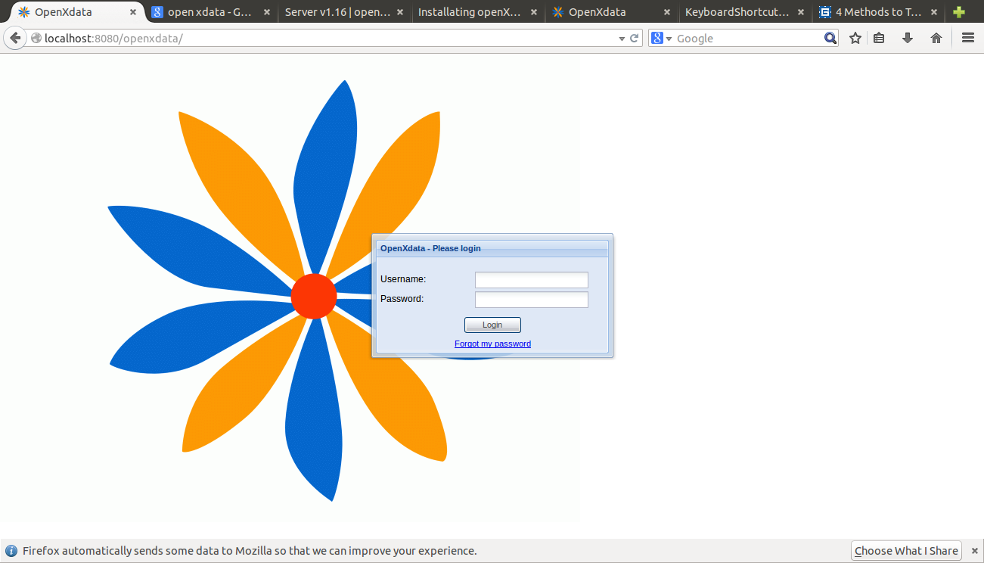
OXD successfully installed!
A screenshot of the welcome screen for OXD. I decided to host OXD on port 8080 as well.

Slide 16
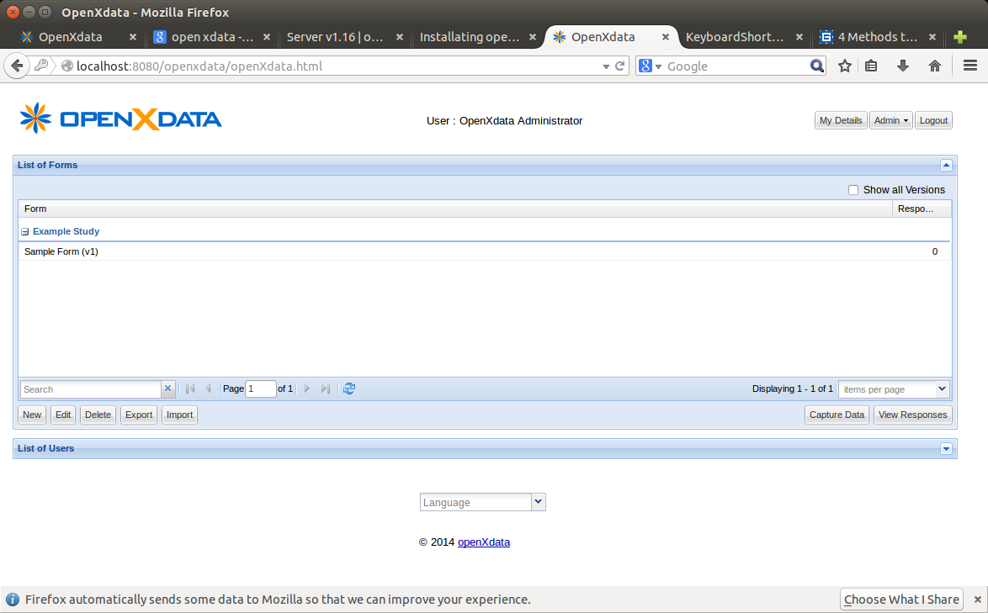
OXD successfully installed!
Form creation screen for Open X Data. Currently logged in as OXD Administrator.

Slide 17
Summary
In the course of installing both ODK and OXD I learned much about Tomcat in particular and web apps in general.
While I was able to host OXD successfully on my computer, to implement a server accessible world-wide would require significantly more research.
If I was to give advice to my self at the start of this project, it would be make sure all the pre-requisites were installed before barging ahead with setup (this was one of the reasons I had to uninstall-reinstall ODK).
While OXD and ODK have similar functionalities, OpenXData is easier to set up, maintain, and has better documentation. However ODK has a more intuitive form-designing application.

